Slide 1
How To Test For Immune Activation By Your Therapeutic Oligonucleotide
19 April, 2018
Art Krieg

Slide 2
Disclosures
Scientific: I discovered the immune stimulatory effects of CpG DNA and am convinced it will be effective for cancer immunotherapy
Financial: I am a founder and shareholder in Checkmate Pharmaceuticals

Slide 3
Agenda
Intro to Nucleic Acid Immunity
What immune pathways may be activated by oligonucleotides?
In vitro screening
In vivo screening
Todays’ focus will be on how to detect immune activation:
identifying the MOA and avoiding it is beyond the scope for today

Slide 4
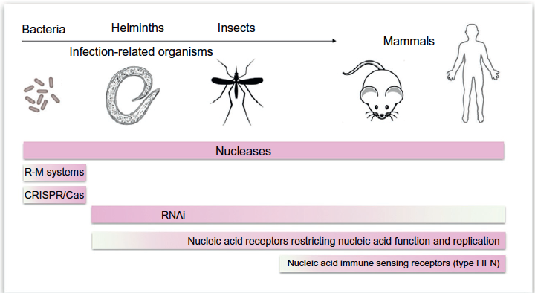
Nucleic Acid Immunity
Defenses Against Foreign Nucleic Acids
Delivering nucleic acids into eukaryotic cells without triggering one or more of these defenses is challenging
Hartmann, Advances Immunol. 2017
4

Slide 5
Agenda
Intro to Nucleic Acid Immunity
What immune pathways may be activated by oligonucleotides?
In vitro screening
In vivo screening

Slide 6
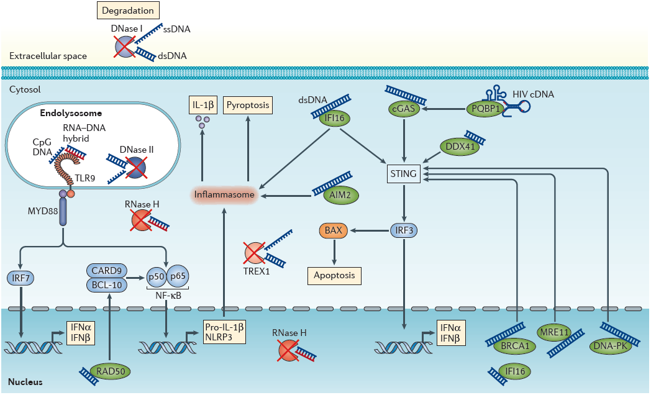
DNA-Sensing Immune Pathways
Schlee and Hartmann, Nature Rev. Immunol, 2016

Slide 7
Species Differences in DNA-Sensing Immune Pathways
In humans but not mice, STING activates inflammasome pathway^{1:} high IL-1b and low IFN
¹Gaidt et al., 2017, Cell 171, 1110–1124

Slide 8
Species Differences in DNA-Sensing Immune Pathways
Mice express TLR9 in many immune cells (inflammation)
Humans express TLR9 only in plasmacytoid dendritic cells (pDC) and B cells: low IL-1b, high IFN
In humans but not mice, STING activates inflammasome pathway^{1:} high IL-1b and low IFN
To detect innate immune activation, screen for:
IFNa/b (IRF)
IL-6/TNF-a (NFkB)
IL-1b (inflammasome)
¹Gaidt et al., 2017, Cell 171, 1110–1124

Slide 9
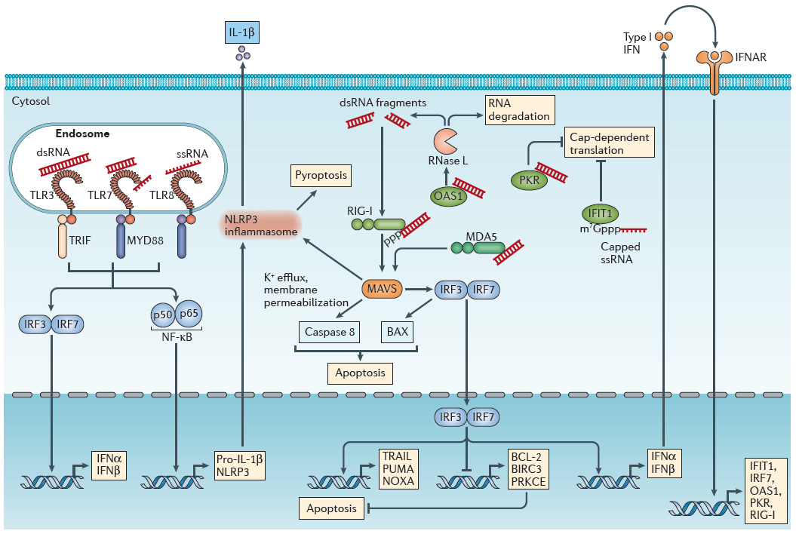
RNA-Sensing Immune Pathways
Mouse TLR8 is not activated by RNA
Schlee and Hartmann, Nature Rev. Immunol, 2016

Slide 10
RNA-Sensing Immune Pathways
Mouse TLR8 is not activated by RNA
RIG-I is commonly activated unintentionally by in vitro transcribed RNA with 5’PPP (or PP)¹
¹Schmidt et al., Proc Natl Acad Sci 2009 Jul 21;106(29):12067-72

Slide 11
Key Concepts
Rodent data do not predict human responses
There are different receptors in endosomes and cytoplasm
  Transfection agents may differentially deliver into endosomes vs cytoplasm
Each receptor detects different elements of nucleic acids
Receptors can trigger distinct or overlapping pathways
For today, will focus on screening for:
  DNA: TLR9 (endosome) and STING (cytoplasm)
  RNA: TLR7/8 (endosome) and RIG-I (cytoplasm)
RIG-I and STING are expressed ubiquitously; TLR are expressed in restricted immune cell populations
11

Slide 12
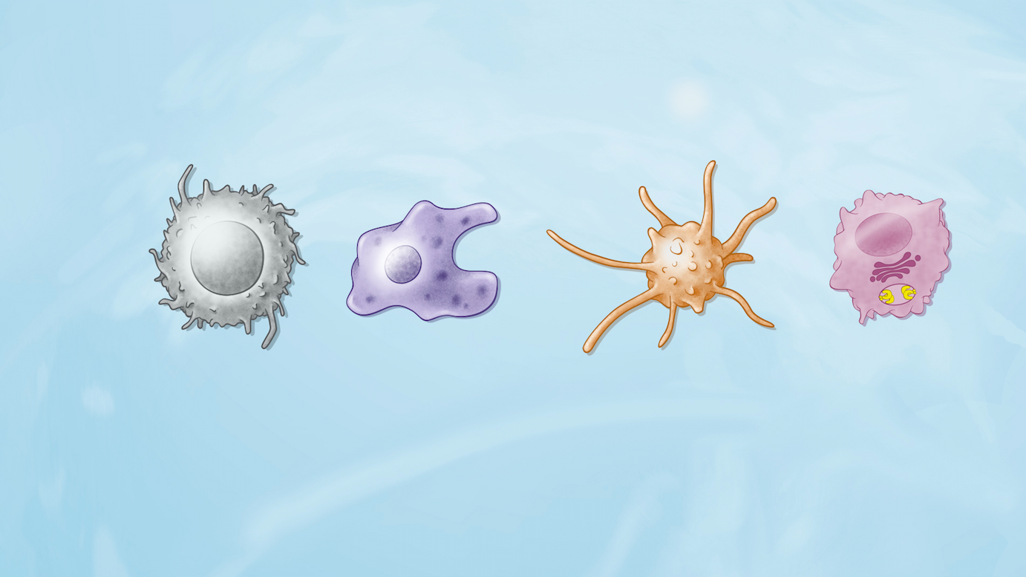
Human Nucleic Acid Immunity:
Cell-Specificity (Examples)
Tumor Monocyte/ Conventional DC Plasmacytoid
macrophage dendritic cell (cDC) DC (pDC)
Receptors: STING, RIG-I STING, RIG-I TLR2/3/5/6/8 TLR7/9
(selected) TLR2/4/5/6/8
Biology: inflammation, inflammation¹, Ag presentation, 1º source of IFN
apoptosis, low IFN low IFN T cell priming regulate tolerance tissue homeostasis vs. immunity
¹inflammation = some or all of IL-6, TNF-a, IL-1b, etc

Slide 13
Agenda
Intro to Nucleic Acid Immunity
What immune pathways may be activated by oligonucleotides?
In vitro screening
In vivo screening

Slide 14
In vitro screening¹
What to screen for:
  IFNa/b (IRF), IL-6/TNF-a (NFkB), IL-1b (inflammasome)
  Optional
    CXCL10 (v sensitive marker for IFN effect) and/or other IFN-inducible chemokines (MIP-1a/b, MCP-1, RANTES, etc)
    IL-12 (p40 assay more sensitive than p70 for biologic effect)
    More complete multiplex panel
Assay method: any multiplex (MDS, luminex, etc.)
Cells to screen in:
  Human PBMC (@3-5 X 10⁶/ml in round-bottom plates)
  Alternate to PBMC: whole blood (not clear if one is better – consider trying both)
  Optional: mouse spleen cells
Timepoint: 24-48 hr
14
¹e.g. for effects of different RNA motifs: Forsbach et al., J. Immunol, 2008, 180:3729

Slide 15
Agenda
Intro to Nucleic Acid Immunity
What immune pathways may be activated by oligonucleotides?
In vitro screening
In vivo screening

Slide 16
In vivo screening
Rapid cytokine induction after single dose
  (~3 hr, test several time points in 1st 24 hr):
Hepatotoxicity¹ screen (typically 2 wk):
  Dose (gapmer ASO): various, but typically ~25-50 mg/kg twice weekly for 2 wks
  species: mouse
Consider renal tox screen:
  Species: rat (same dose as hepatotox)
¹MOA of hepatotoxicity may be immune or other (see references)
16

Slide 17
Common Issues In The Preclinical Immunologic Evaluation Of RNA Or DNA
Failure to use appropriate control
  A commonly published “control” RNAi lacks immune stimulatory sequences
  Need to use appropriate TLR control – e.g., a TLR3 ligand does not control for a TLR7/8 ligand!
Mouse models lack functional TLR8
  can only detect TLR3, TLR7, RLR responses
Looking at the wrong time point
  in vivo serum cytokine expression is transient, and in rodents typically peaks at 1-6 hr (depending on cytokine), may be gone by 24 hr
Looking at the wrong readout
  Use of cell lines that don’t express TLR (RLR expression is more universal)
  IFN-α expression in mice is very insensitive assay for IFN effect
  Much more sensitive are IFN-inducible genes like IP-10, Mx, MIP-1, etc.

Slide 18
ASO And RNAi Biology Are Determined Not By Design, But By Pharmacology
ASO and RNAi doses are usually >>> doses required for TLR activation (100s of mg vs 1-10 mg)
ASO, RNAi, other oligos are internalized into endosomes
Endosomal oligos can activate TLR before escaping into cytoplasm and reaching concentrations required for ASO or RNAi activity
Several MOA may co-exist
With unmodified PS oligos immune and aptamer effects are more likely to occur in vivo than antisense or RNAi
Many published in vivo antisense and RNAi studies lack adequate controls for immune effects

Slide 19
Nucleic Acid Immunity:
Common Clinical Signs In Humans
  “flu-like symptoms” (e.g. fatigue, fever, chills), ISR (early or chronic)
    Commonly seen with ~any phosphorothioate backbone nucleic acid therapeutic
    Sequence-related
    Modification-related (reduced by 2’ sugar substitutions)
    Formulation-related
    Concentration-related
19

Slide 20
Nucleic Acid Immunity:
Potential Clinical Signs In Humans
(esp. with LNP or oligo-conjugates)
  Hypotension, cytokine release syndrome (CRS), symmetrical back pain, flushing, swelling, fever…
    If immediate during injection (1st 5 minutes):
    Occurs on 1st dose: consider complement activation: check serum C3a, C4d, CH50, etc.
    Occurs on subsequent doses: consider IgE anti-drug Ab (type I immediate hypersensitivity reaction) check acute serum tryptase (released by activated mast cells, only elevated acutely within 2-3 hr), test for anti-drug IgE
  If delayed after injection (typically within 1st 24-48 hours):
    First dose only – idiosyncratic reaction, not due to anti-drug IgG, maybe formulation-related
    Late in dosing only – test for anti-drug IgG
      Anti-ssDNA Ab are common, mostly not sequence-specific, and are seldom if ever of any pathologic significance
      anti-dsDNA (e.g., SLE-associated) are rare, and are usually a false positive of the commercial anti-dsDNA ELISA – require confirmation of any + result with crithidia DNA or other more specific assay
20

Slide 21
Issues to consider with formulations
The same formulation in vivo will behave very differently depending on the payload (e.g., “Smarticles” – used in humans by ProNAI, Mirna, and Mina)
  Unmodified RNA – severe CRS requiring high dose steroid prophylaxis
  Modified RNA – well tolerated
  DNA – mild-moderate immune symptoms
Different formulations may deliver the same nucleic acid into different cells or intracellular compartments, inducing distinct immune effects
21

Slide 22



PMO Are Not Detected By Immune Receptors
MOE
(Mipomersen)
OMe
(Drisapersen)
RNA
(siRNA)
Uncharged, do not activate TLRs, other innate immune
Very low protein binding leads to rapid renal excretion
does not activate RISC/RNase H: only acts as steric blocker
Dosed up to 50 mg/kg/wk in humans for >3 years
Polyanion – can activate TLRs
High protein binding (largely nonspecific)
Can be designed to degrade RNA via RISC or RNase H or as steric blockers
Dose limiting toxicities ~4-6 mg/kg/wk
Phosphorodiamidate Morpholino Oligomers (PMOs)
Phosphorothioate Backbone (with 2’-MOE or 2’-OMe modified sugars)
22
Notes:
Drug-like qualities??

Slide 23
References/Further Reading
Burdick, et al. (2014). Nucleic acids research, 42:4882-4891. study of the in vivo tox of a panel of LNA gapmer ASO and possible non-immune MOA
Burel, et al. (2015). Nucleic acids research, 44(5), 2093-2109. reports off-target RNase H cleavage as common MOA of hepatotoxic gapmers
Gaidt et al., (2017), Cell 171, 1110–1124: shows human-specific effects of STING on inflammasome activation
Forsbach, et al. (2008) J. Immunol. 180:3729-3738: shows different RNA sequence motifs for TLR7 and TLR8 have distinct effects
Janas, et al. (2018). Nature communications, 9:723. analysis of MOA of GalNAc siRNA mediated hepatotoxicity
Linehan, M. M., Dickey, T. H., Molinari, E. S., Fitzgerald, M. E., Potapova, O., Iwasaki, A., & Pyle, A. M. (2017). bioRxiv, 178343. nice SAR work for RIG-I ligand development
Robbins, M., et al. (2007). Molecular Therapy, 15(9), 1663-1669. Demonstrates that 2-O-methyl-modified RNAs act as TLR7 antagonists
Schlee, M., & Hartmann, G. (2016). Nature reviews Immunology, 16(9), 566-580. Great review article on the broad scope of nucleic acid immunity
Schmidt et al., Proc Natl Acad Sci 2009 Jul 21;106(29):12067-72 highlights the potential for in vitro transcribed RNA to activate RIG-I
Tluk, S., et al. (2009). International immunology, 21(5), 607-619. demonstrates the effects of certain base modification on RNA immune activation.
Vollmer, J., et al. (2002). Antisense and Nucleic Acid Drug Development, 12(3), 165-175. reports that in a PS ODN, CpG methylation does not abolish TLR9 activation

Slide 24
The Immune System Is Smarter Than We Are!
Our understanding of the immune pathways that detect nucleic acids is incomplete and evolving
Species-specific differences especially are poorly defined – do not expect rodent studies to predict human results!
Some of what I have said is surely wrong, and most will be incomplete
24

Slide 25
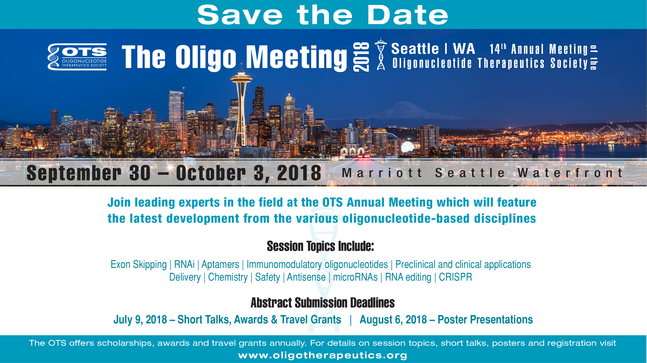

Slide 26
Questions?

Slide 27
Back-up slides

Slide 28
Nucleic Acid Immune Receptors Being Targeted In The Clinic
Receptor/location | Cells expressing | Ligand | Signaling pathway | Biology
 |  | Present in self?
TLR3/endosome | Many immune | dsRNA yes | TRIF/IRF3 | IFN, inflammatory cytokines
TLR7/8/ endosome | Many immune | ssRNA yes | MyD88/IRF3 | IFN, inflammatory cytokines
TLR9/ endosome | Plasmacytoid DC (pDC), B cells | CpG DNA No* | MyD88/IRF3,7 | Highest IFN
cGAS/ cytoplasm | ~All | dsDNA yes | STING | High TNF, inflammatory cytokines, low IFN
RIG-I/ cytoplasm | ~All | 5’ PPP dsRNA No | MAVS | IFN, inflammatory cytokines, tumor apoptosis

Slide 29
How Are Self And Foreign Nucleic Acids Distinguished?
Modification of self nucleic acids
  DNA has CpG methylation
  RNA has 5’ cap, N1 2’-O-methyl, etc.
Compartmentalization of the receptors and self nucleic acids
  DNA normally is present only in the nucleus
  RNA normally not in the endosomes
  This compartmentalization can fail in stressed or damaged cells
Nucleases digest self nucleic acids continuously
  Maintain a low background of free nucleic acid, against which pathogen nucleic acid or cell damage can be detected
  Genetic deficiency of nucleases results in autoinflammatory diseases

Slide 30
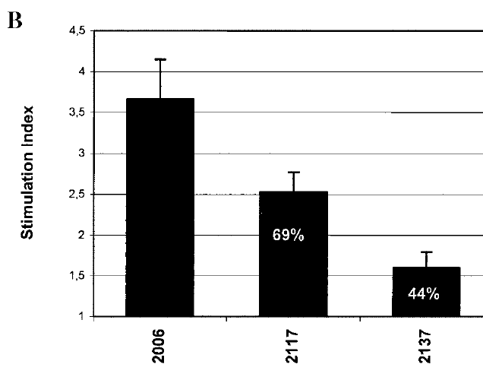
CpG Methylation Does Not Abolish TLR9 Activation By Phosphorothioate (PS) Oligos
CpG control
^{m}CpG oligo
GpC oligo
CpG methylation ~eliminates activation by PO CpG DNA (not shown)
For PS oligos, CpG>^{m}CpG>TpG>GpC
The best way to avoid CpG effects in PS DNA is sequence selection to exclude CpG!
Vollmer et al., Antisense and nucleic acid drug development, 2002

Slide 31
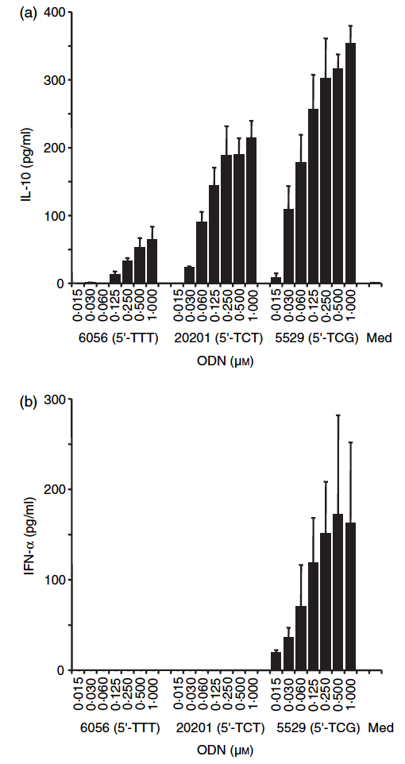
CpG-Free Polypyrimidines Induce Noncanonical TLR9 Response From Human Cells
PS Oligonucleotides to left are:
TTTTTTTTTTTTTTTTT
TCTTTTTTTTTTTTTTT
TCGTTTTTTTTTTTTTT
IRF7 NFkB
PO oligos without CpG motifs do not activate TLR9
PS oligos with no unmethylated CpG still activate TLR9 if they have:
  Polypyrimidine tracts (4 or more T or TC: not C)
  Methylated CpG
Noncanonical TLR9 ligands (MANY/ALL PS ODN)
  induce IL-10, B cell proliferation (via NFkB)
  do not induce type I IFN response (IRF7)
Vollmer et al., Immunology, 2004

Slide 32
Different RNA Motifs Activate Human TLR7, TLR8
~80% of random RNAi will contain TLR7/8 motifs
~all mRNA should contain TLR7/8 motifs
IFN-alpha
TLR7
TNF-alpha
TLR8
IL-12p40
TLR8
IFN-gamma
TLR8
IFN-alpha
TNF-alpha
IL-12p40
IFN-gamma
TLR7 ORN
„UCA“ motif
R-1886
TLR8 ORN
„AUUAUU“ motif
R-1354
TLR7/8 ORN
„GUUGUU“ motif
R-1362
DOTAP
Medium
Forsbach A.
JI 2008
0
5000
10000
0
50 000
100 000
50 000
100 000
5e+4
1e+5
0
5000
10000
0
5e+4
1e+5
Cytokine production [pg/ml]
Human PBMC Mean±SD 3 Donors, 24h, ELISA.
Notes:
Slide already used for official presentations (not disclosing nature of TLR7 class)

Slide 33
Specific 2’OMe Modifications Can Suppress RNA-mediated TLR7/8 Activation
2’OMe Substitution in RNA
2’OMe Outside Motif
C
U,G
A,G
Tluk S.
Int. Immunology 2009
Human PBMC 3 Donors Mean±SD, 24h, ELISA.

Slide 34
Specific Single Chemical Modifications CAN Suppress RNA-mediated TLR7 And TLR8 Immune Effects
2’OMe Substitution in RNA
Local RNA concentrations after SC injection may be >100 μM
2’OMe Outside Motif
C
U,G
A,G
Tluk S.
Int. Immunology 2009
Human PBMC 3 Donors Mean±SD, 24h, ELISA.

